Slide 1
Java Capability
Object Oriented
Programming - OOP

Slide 2
Agenda
Course on Object Oriented Programming in Java.
Programming language.
Class.
Object.
Constructors.
Inheritance.
Polymorphism
Super, this, final, variable, null, instanceof,

Slide 3
Prerequisites
Basic knowledge of any programming language.
OOP would be added advantage.

Slide 4
programming language
A programming language is a set of commands, instructions, and other syntax use to create a software program.
Languages that programmers use to write code are called "high-level languages" or source code.
This code can be compiled into a "low-level language," which is recognized directly by the computer hardware.
Low-level languages include assembly and machine languages.
High-level languages include C++, Java, Perl, and PHP.
Most source code must first be compiled in order to run.

Slide 5
Programming Languages cont..
Object oriented programming
Object oriented programming aims to implement real world entities.
The main aim of OOP is to bind together the data and the functions that operates on them so that no other part of code can access this data except that function.
OOP provides some concepts:
Object
Class
Inheritance
Polymorphism
Abstraction
Encapsulation

Slide 6
Class
A class is a group of objects which have common properties.
Class is a template or blueprint from which objects are created. It is a logical entity.
A class in Java can contain:
Fields / variables / Attributes / state
Methods / Functions / Behavior
Constructors
Blocks
Nested class
Class is a user defined data type like structures and unions in C.

Slide 7
Object
Object is an instance of a class. Class is a template or blueprint from which objects are created.
An object has three characteristics:
state: represents data (value) of an object.
behavior: represents the behavior (functionality) of an object such as deposit( ), withdraw( )etc.
identity: Object identity is typically implemented via a unique ID. The value of the ID is not visible to the external user. But, it is used internally by the JVM to identify each object uniquely.
For Example: Ink Pen is an object derived from the class Pen. Its name is Reynolds, color is white etc. known as its state. It is used to write, so writing is its behavior.
Object is created using new keyword.

Slide 8
Constructor
Constructor in java is a special type of method that is used to initialize the object.
Constructor is called when an instance of object is created and memory is allocated for the object.
Rules for creating java constructor. There are basically two rules defined for the constructor.
Constructor name must be same as its class name.
Constructor must have no explicit return type.
Types of java constructors
Default constructor (JVM provided).
Parameterized constructor.

Slide 9
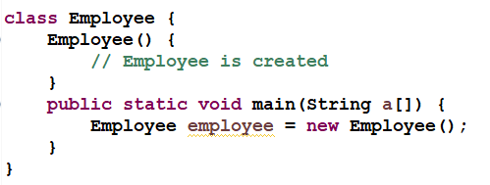
default constructor
Java compiler creates a default constructor if your class doesn't have any constructor.
Default constructor is used to provide the default values to the object like 0, null etc. depending on the type.
The default constructor is ALWAYS a no-arg constructor.
A constructor that has no parameter(s) is known as default constructor.
Example

Slide 10
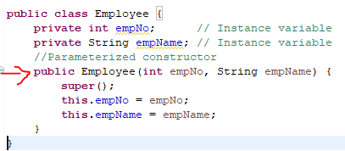
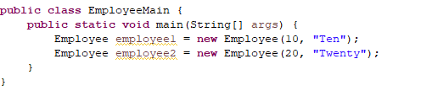
Parameterized constructor
A Constructor with arguments(or parameters) is known as Parameterized constructor.
Parameterized constructor is used to provide different values to the distinct objects.

Slide 11
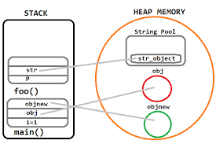
Java terminology
Reference in java
A reference is a value that refers to a another value.
A reference is an address that indicates where an object's variables and methods are stored.
When assigning an object to a variable or pass an object to a method as an argument, You aren't even using copies of the objects. Instead, you're using references to those objects.
Objects are created in Heap memory and reference in stack.

Slide 12
Memory Allocation in Java
The JVM divided the memory into following sections.
Heap
Stack
Code
Static
The code section contains your bytecode.
The Stack section of memory contains methods, local variables, and reference variables.
The Heap section contains Objects (may also contain reference variables).
The Static section contains Static data/methods

Slide 13
Method Overloading
If a class has multiple methods having same name but different in parameters, it is known as Method Overloading.
If we have to perform only one operation, having same name of the methods increases the readability of the program.
Different ways to overload the method
There are two ways to overload the method in java
By changing number of arguments
By changing the data type

Slide 14
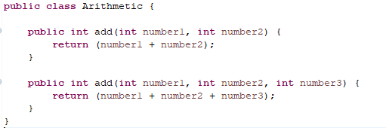
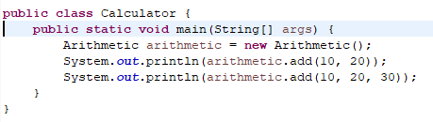
Example for Method Overloading

Slide 15
Constructor Overloading
Constructor overloading is a technique in Java in which a class can have any number of constructors that differ in parameter lists.
The compiler differentiates these constructors by taking into account the number of parameters in the list and their type.

Slide 16
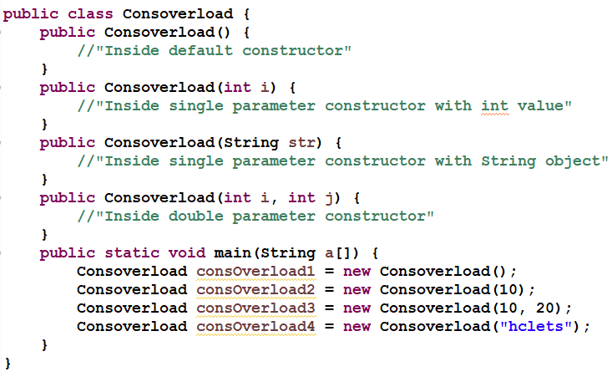
Example

Slide 17
Encapsulation
Encapsulation in Java is a mechanism of wrapping the data (variables) and code acting on the data (methods) together as a single unit.
In encapsulation, the variables of a class will be hidden from other classes, and can be accessed only through the methods of their current class. Therefore, it is also known as data hiding.
To achieve encapsulation in Java −
Declare the variables of a class as private.
Provide public setter and getter methods to modify and view the variables values.

Slide 18
Encapsulation Example
public class EncapulationTest {
private String name;
private String id;
private int age;
public int getAge() {
return age;
}
public String getName() {
return name;
}

Slide 19
Encapsulation Example Contd…
public String getId() {
return idNum;
}
public void setAge( int newAge) {
age = newAge;
}
public void setName(String newName) {
name = newName;
}
public void setId( String newId) {
idNum = newId;
}}

Slide 20
Encapsulation Example Contd…
public class RunEncap {
public static void main(String args[]) {
EncapsulationTest encap = new EncapsulationTest();
encap.setName("James");
encap.setAge(20);
encap.setIdNum("12343ms");
System.out.print("Name : " + encap.getName() + " Age : " + encap.getAge());
}
}
Output:
Name : James Age : 20

Slide 21
Inheritance
Inheritance can be defined as the process where one class acquires the properties (methods and fields) of another class. With the use of inheritance the information is made manageable in a hierarchical order.
The class which inherits the properties of other is known as subclass (derived class, child class) and the class whose properties are inherited is known as superclass (base class, parent class).
extends is the keyword used to inherits state and behavior of a class.
Syntax
class Super { }
class Sub extends Super { }
When inherit from an existing class, we reuse methods and fields of parent class. Moreover, you can add new methods and fields in your current class also.
Inheritance represents the IS-A relationship, also known as parent-child relationship.

Slide 22
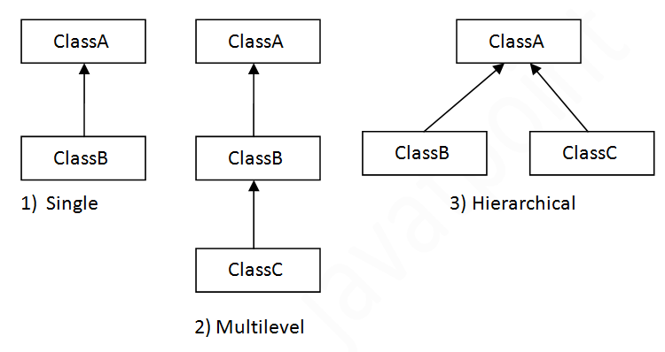
Types of inheritance in java

Slide 23
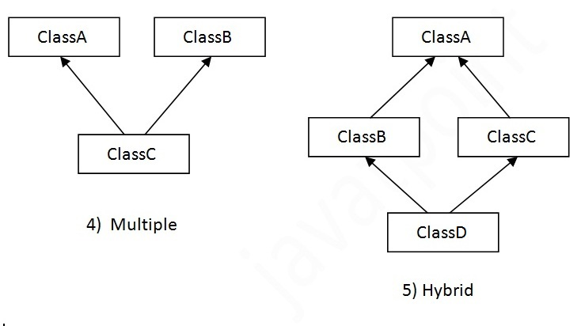
Types of inheritance in java
Multiple inheritance is not supported in java

Slide 24
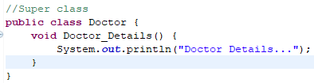
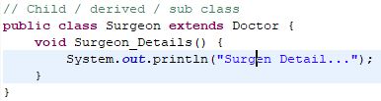
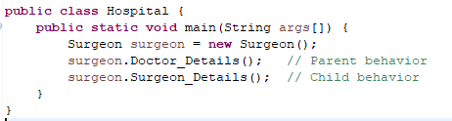
Inheritance Example

Slide 25
Polymorphism
Polymorphism in java is a concept by which we can perform a single action by different ways.
Polymorphism is derived from 2 Greek words: poly and morphs. The word "poly" means many and "morphs" means forms. So polymorphism means many forms.
Two Types
→Compile Time Polymorphism or Static Polymorphism
Method Overloading
Constructor Overloading
→Runtime Polymorphism or Dynamic Method Dispatch or Dynamic Polymorphism
1. Method Overriding

Slide 26
Method Overriding
When a method in a sub class has same name, same number of arguments and same type signature as a method in its super class, then the method is known as overridden method.
Method overriding is also referred to as runtime polymorphism.
Rules for Java Method Overriding
method must have same name as in the parent class
method must have same parameter as in the parent class.
must be IS-A relationship (inheritance).

Slide 27
Real example of Java Method Overriding

Slide 28
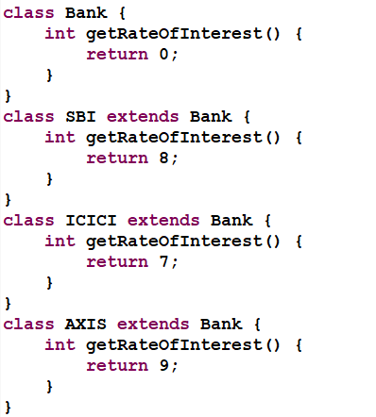
Method Overriding cont..

Slide 29
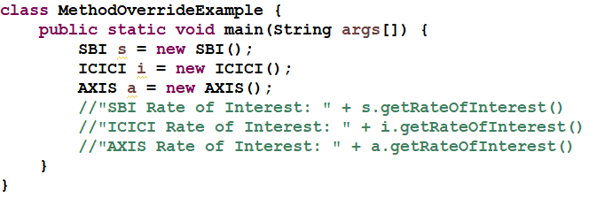
Method Overriding cont.
Child Class Method

Slide 30
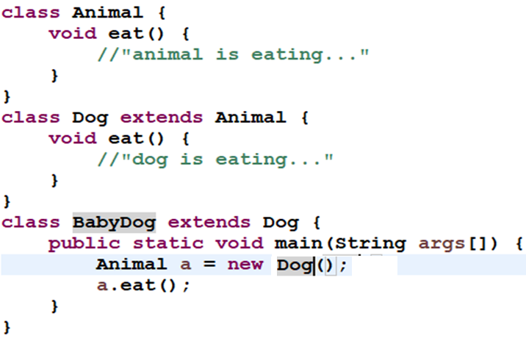
Dynamic Method Dispatch

Slide 31
Dynamic Method Dispatch cont.
When an overridden method is called through a reference of parent class, then type of the object determines which method is to be executed. Thus, this determination is made at run time.
Since both the classes, child class and parent class have the same method eat. Which version of the method(child class or parent class) will be called is determined at runtime by JVM.
In the above program the method of child class is to be executed because which method is to be executed is determined by the type of object and since the object belongs to the child class, the child class version of eat() is called.

Slide 32
Super Keyword
The super keyword in java is a reference variable which is used to refer immediate parent class object.
Whenever you create the instance of subclass, an instance of parent class is created implicitly which is referred by super reference variable
Usage of java super Keyword
super can be used to refer immediate parent class instance variable.
super can be used to invoke immediate parent class method.
super( ) can be used to invoke immediate parent class constructor.

Slide 33
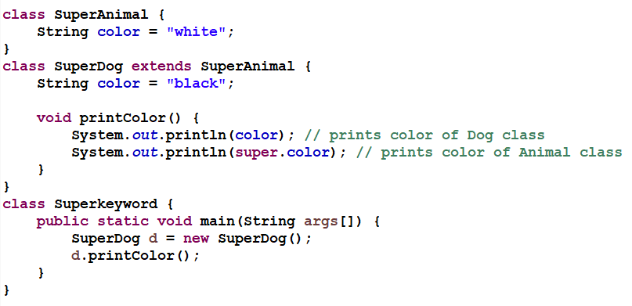
Super Keyword Example
Notes:
class SuperAnimal {
String color = "white";
}
class SuperDog extends SuperAnimal {
String color = "black";
void printColor() {
System.out.println(color); // prints color of Dog class
System.out.println(super.color); // prints color of Animal class
}
}
class Superkeyword {
public static void main(String args[]) {
SuperDog d = new SuperDog();
d.printColor();
}
}

Slide 34
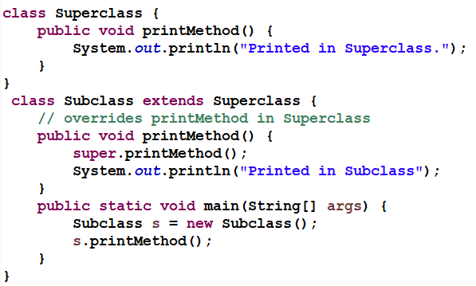
Super Method Example

Slide 35
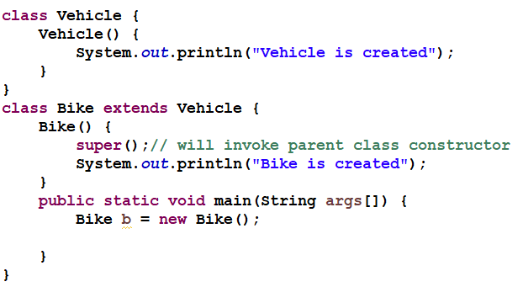
Super is used to invoke parent class constructor

Slide 36
Final Keyword
Final is a keyword in Java that is used to restrict the user and can be used in many respects. Final can be used with:
Class
Methods
Variables
Class declared as final
When a class is declared as final, it cannot be extended further. Here is an example what happens within a program

Slide 37
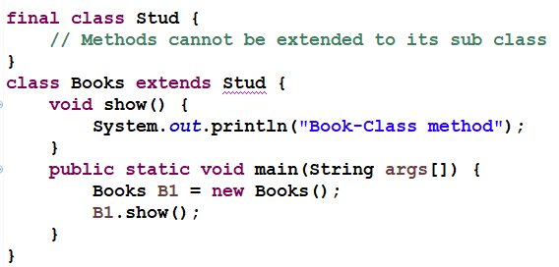
Final Keyword - Class

Slide 38
Final Keyword - method
Method declared as Final
A method declared as final cannot be overridden; this means even when a child class can call the final method of parent class without any issues but the overriding will not be possible.
Sample program showing what is not valid within a Java program when a method is declared as final.

Slide 39
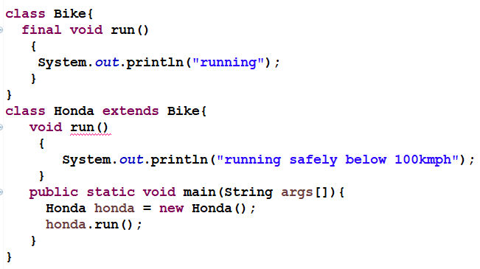
Final Keyword - method

Slide 40
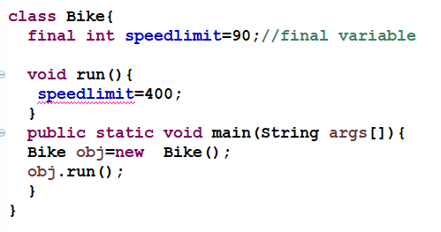
Final Keyword - variable
Java final variable
If you make any variable as final, you cannot change the value of final variable(It will be constant).

Slide 41
Abstract Class
If a class contain any abstract method then the class is declared as abstract class. An abstract class is never instantiated. It is used to provide abstraction. Although it does not provide 100% abstraction because it can also have concrete method.
Method that are declared without any body within an abstract class are called abstract method.
The method body will be defined by its subclass.
Abstract method can never be final and static.
Any class that extends an abstract class must implement all the abstract methods declared by the super class.
Syntax :
abstract class ClassName { }

Slide 42
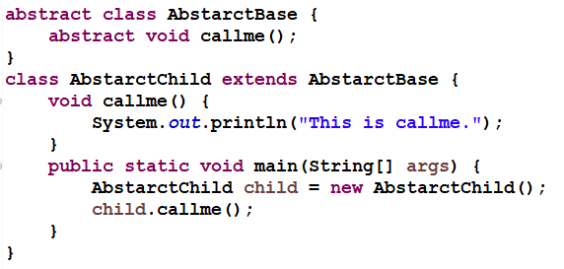
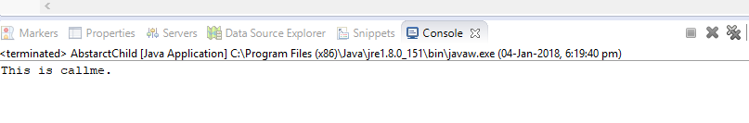
Abstract Class Example
Output:

Slide 43
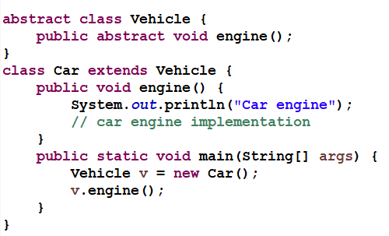
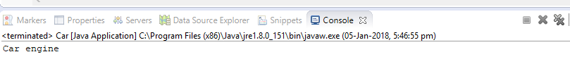
Abstract Class Example
Output:

Slide 44
Interface
Interface is a pure abstract class. They are syntactically similar to classes, but you cannot create instance of an Interface and their methods are declared without any body.
Interface is used to achieve complete abstraction in Java.
Java Interface also represents IS-A relationship.
It cannot be instantiated just like abstract class.
Syntax :
interface InterfaceName { }

Slide 45
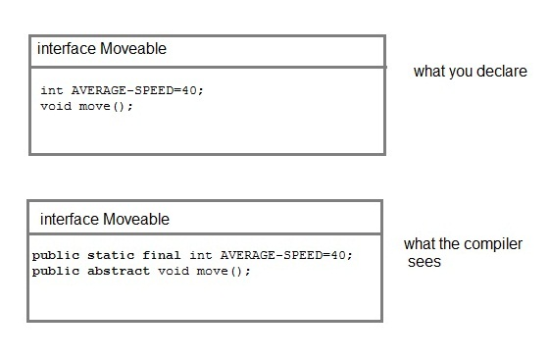
Interface
NOTE : Compiler automatically converts methods of Interface as public and abstract, and the data members as public, static and final by default.

Slide 46
Why use Java interface?
It is used to achieve abstraction.
By interface, we can support the functionality of multiple inheritance.

Slide 47
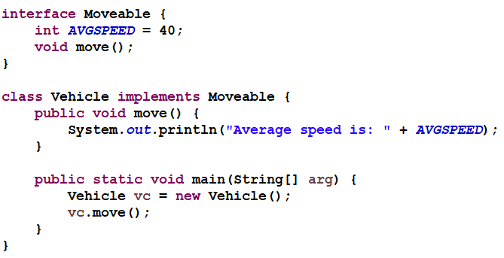
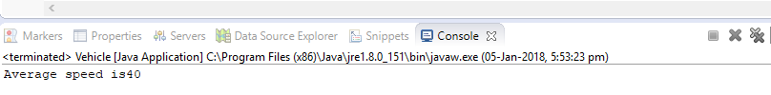
Interface Example
Output:

Slide 48
Interface Another Example
interface Bank{
float rateOfInterest();
}
class SBI implements Bank{
public float rateOfInterest(){return 9.15f;}
}
class PNB implements Bank{
public float rateOfInterest(){return 9.7f;}
}

Slide 49
Interface Another Example
class TestInterface{
public static void main(String[] args){
Bank bank=new SBI();
System.out.println("ROI: "+bank.rateOfInterest());
}
}

Slide 50
Quiz
State True or False.
The Purpose of default constructor is to provide the default values to the object like 0, null etc. depending on the type.
Predict the output:
public class MyDefaultConstructor {
public MyDefaultConstructor( ){
System.out.println("I am inside default constructor...");
}
public static void main(String[ ] args){
MyDefaultConstructor mdc = new MyDefaultConstructor();
}
}

Slide 51
Quiz
Is final method inherited?
Yes, final method is inherited but you cannot override it.
class Bike{
final void run() { System.out.println("running...");}
}
class Honda2 extends Bike{
public static void main(String args[]){
new Honda2().run();
}
}

Slide 52
Access Modifiers in java
There are two types of modifiers in java:
access modifiers and
non-access modifiers.
non-access modifiers such as static, abstract, synchronized, transient etc.
The access modifiers in java specifies accessibility (scope) of a data member, method, constructor or class.
There are 4 types of java access modifiers:
private
default
public
protected

Slide 53
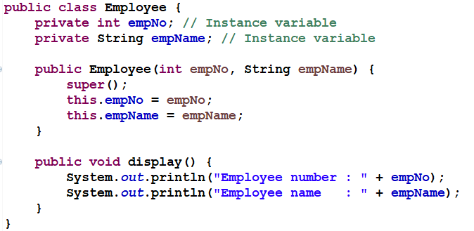
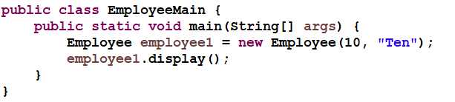
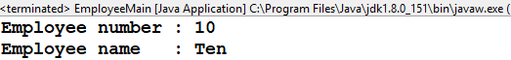
private access modifier
The private access modifier is accessible only within class.
If private members are accessed from outside the class, there would be compile time error.
If a class constructor is private, you cannot create the instance of that class from outside the class.

Slide 54
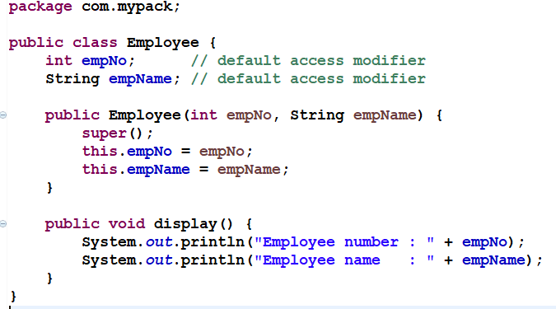
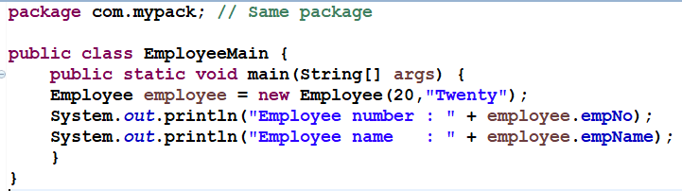
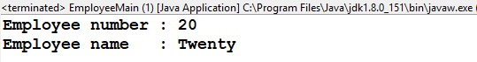
default access modifier
Don’t mention any modifier, it is treated as default by default.
The default modifier is accessible only within package.

Slide 55
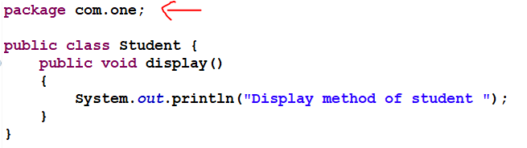
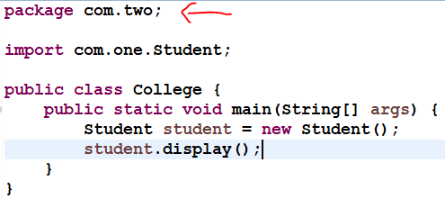

public access modifier
The public access modifier is accessible everywhere.
It has the widest scope among all other modifiers.

Slide 56
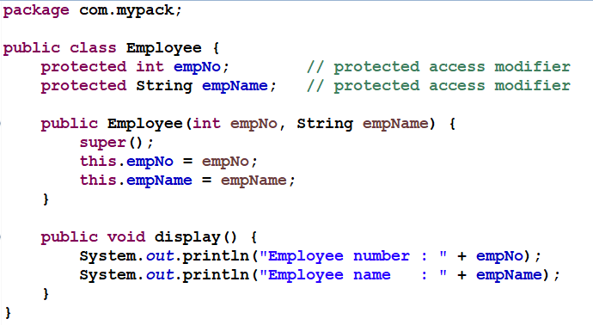
protected access modifier
The protected access modifier is accessible within package and outside the package but through inheritance only.
The protected access modifier can be applied on the data member, method and constructor.
It can't be applied on the class.

Slide 57
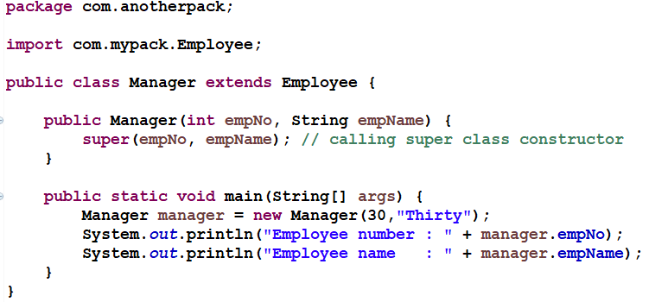
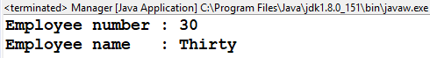
protected access modifier

Slide 58
java access modifiers
Access Modifier | within class | within package | outside package by subclass only | outside package
Private | Y | N | N | N
Default | Y | Y | N | N
Protected | Y | Y | Y | N
Public | Y | Y | Y | Y

Slide 59
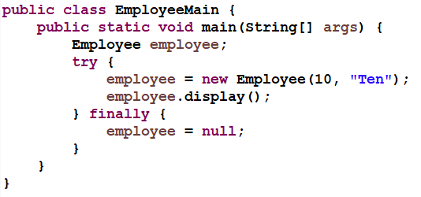
null in Java
‘null’ is literal in Java and keyword in java.
Every class is instantiated ( new ClassName( ) ) and memory is created in heap and referred to a variable of that class or parent class.
Example : ClassName referenceVariable = new ClassName( ) ; // Object reference
To dereference the object reference we use ‘null’.
Example : referenceVariable = null ;
In Java, null is associated with java.lang.NullPointerException

Slide 60
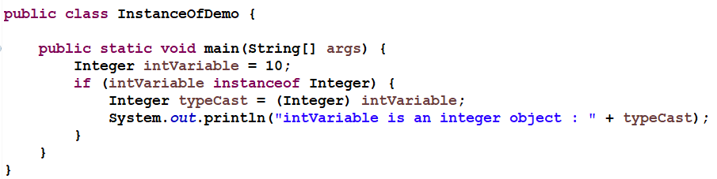
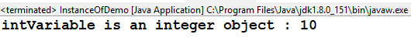
instanceof operator
The java instanceof operator is used to test whether the object is an instance of the specified type (class or subclass or interface).

Slide 61
Variable
An object stores its state in fields / variable. Example : int speed = 0;
Are fields assigned a default value if they are not explicitly initialized.
Kinds of variables:
Instance Variables (Non-Static Fields).
Class Variables (Static Fields).
Local Variables.
"non-static fields", that is, fields declared without the static keyword. Non-static fields are also known as instance variables because their values are unique to each instance of a class.

Slide 62
Variable
A class variable is any field declared with the static modifier; this tells the compiler that there is exactly one copy of this variable in existence, regardless of how many times the class has been instantiated.
static int empNo = 6;
A Local Variables : variable declared inside the body of the method is called local variable. Variable available only within that method.
class Employee{
private int empNo =10; //instance variable
static float basicSalary = 5000f; //static variable
public void method(){
int n=90; //local variable
}
}//end of class

Slide 63
Eclipse Generating Code
Type sysout and press CTRL + SPACE (the autocompletion) and it will be automagically changed to System.out.println( );
Type "for" and press CTRL + SPACE to change it to a skeleton of a for loop.
To list of all templates open Window -> Preferences and type templates into the search box.
CTRL + SPACE bar in eclipse. Never can remember the signature of a method you want to override? Never mind, hit CTRL + SPACE and you will get a list.

Slide 64
Refactoring
Refactoring is the process of changing a software system in such a way that it does not alter the external behavior of the code yet improves its internal structure.
Examples of refactoring
Rename : Methods, variables, classes or other java items
Move Class : Moving a class into a package.
Extract Method : Break up long methods to improve readability and maintainability.
Extract Superclass : Methods which are common be mapped in superclass

Slide 65
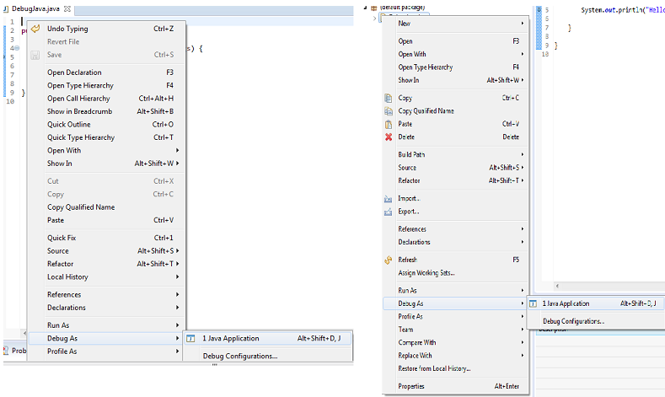
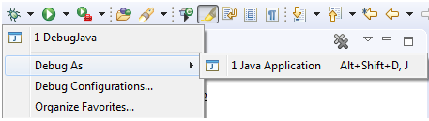
Debugging
1. Launching and Debugging a Java program
A Java program can be debugged simply by right clicking on the Java editor class file from Package explorer. Select Debug As → Java Application or use the shortcut Alt + Shift + D, J instead.

Slide 66
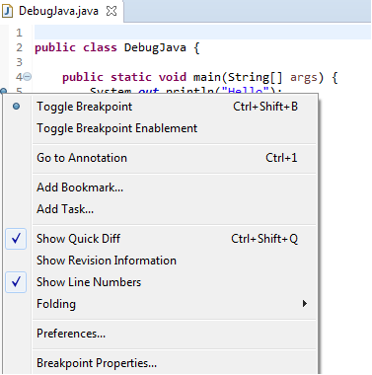
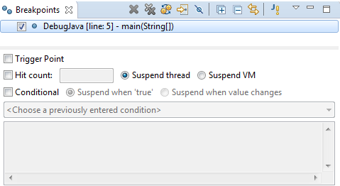
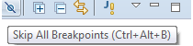
Breakpoints
A breakpoint is a signal that tells the debugger to temporarily suspend execution of your program at a certain point in the code.
To define a breakpoint in your source code, right-click in the left margin in the Java editor and select Toggle Breakpoint. Alternatively, you can double-click on this position.

Slide 67
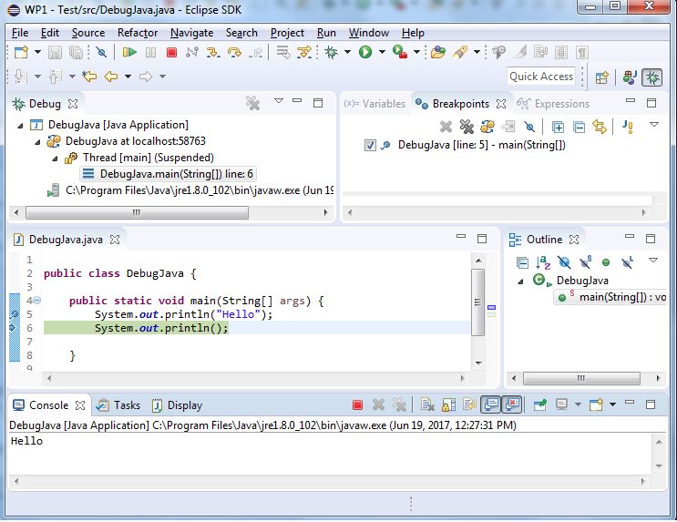
Debug Perspective
Debug view – Visualizes call stack and provides operations on that.
Breakpoints view – Shows all the breakpoints.
Variables/Expression view – Shows the declared variables and their values. Press Ctrl+Shift+d or Ctrl+Shift+i on a selected variable or expression to show its value. You can also add a permanent watch on an expression/variable that will then be shown in the Expressions view when debugging is on.
Display view – Allows to Inspect the value of a variable, expression or selected text during debugging.
Console view – Program output is shown here.

Slide 68
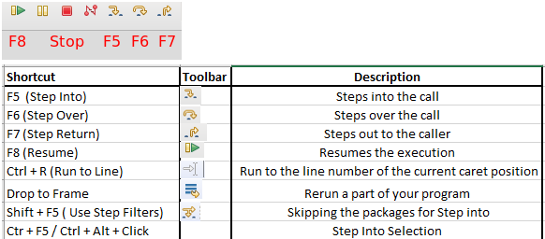
Stepping commands

Slide 69
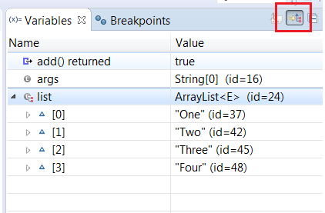


Debug - Windows

Slide 70
References & Further Studies
https://docs.oracle.com/javase/tutorial/java/concepts/index.html
https://www.javatpoint.com/java-tutorial

